Slide 1
Merger Due Diligence
ACUARP Region 1 Meeting – May 10, 2024

Slide 3
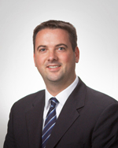
Today’s Presenters
Dean Rohne, CPA
Principal
Austin, Texas Office
CLA (CliftonLarsonAllen LLP)
512-276-6048
dean.rohne@CLAconnect.com
Dean Rohne is a financial services principal with CLA. He is a graduate of Winona State University, where he majored in accounting. A CPA and certified internal auditor, Dean has over 25 years’ experience providing audit, internal audit, and consulting services to community financial institutions. He has provided consulting on business lending, enterprise risk management, product costing and profitability, and asset/liability management. Dean is a frequent speaker at local and national conferences on topics that include supervisory/audit committee responsibilities, internal controls, and accounting-related topics.

Slide 4
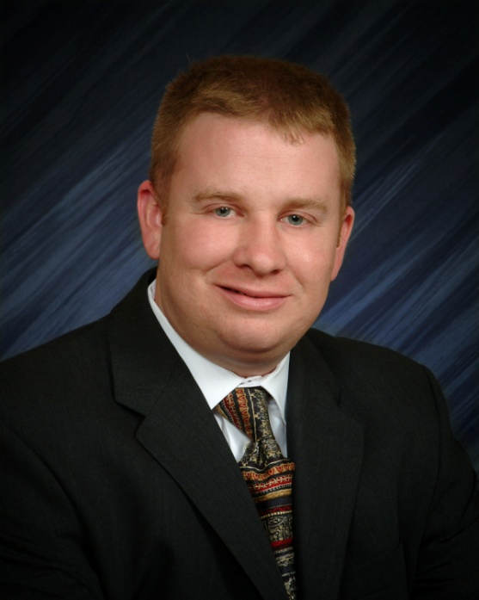
Today’s Presenters
Stephen J.M. Schiltz, CPA
Principal
Tucson, Arizona Office
CLA (CliftonLarsonAllen LLP)
520-352-1259
stephen.schiltz@CLAconnect.com
Steve Schiltz is a principal with CLA’s Tucson office. He began his career with CLA in 2002 and has extensive experience providing assurance and consulting services to community financial institutions. Steve has made presentations to management teams, supervisory committees, and boards of directors, as well as national speaking engagements and webinars.
A licensed CPA in Arizona and Texas, Steve is a member of the AICPA, Arizona Society of CPAs, and the Beta Gamma Sigma Honor Society. He received his bachelor’s in accounting, cum laude, from the University of Arizona in Tucson.

Slide 5
CLA Statistics

Slide 6

Polling Question
Is your credit union considering a merger?
  Yes- we will be the survivor/acquiror
  Yes- we will be the target
  No

Slide 7
Credit Union Trends

Slide 8
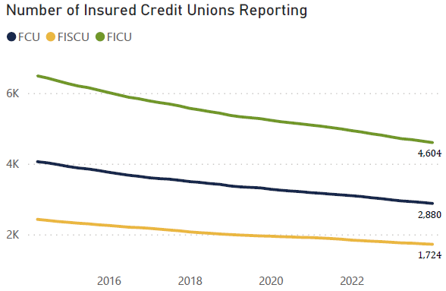
Source: NCUA’s Financial Trends in Federally Insured Credit Unions 2023 Q4

Slide 9
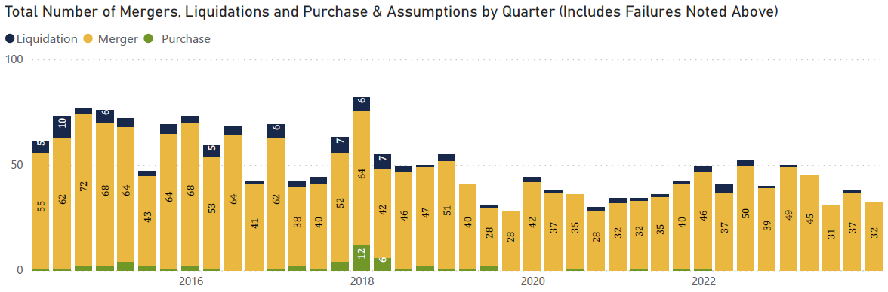
Source: NCUA’s Financial Trends in Federally Insured Credit Unions 2023 Q4

Slide 10
Reasons for Mergers
Weak financial condition (loan losses)
Service capabilities (technology)
Succession (president/CEO/manager retiring)
Field of membership disruption (single sponsor)
Recordkeeping problems (account reconciliations)

Slide 11
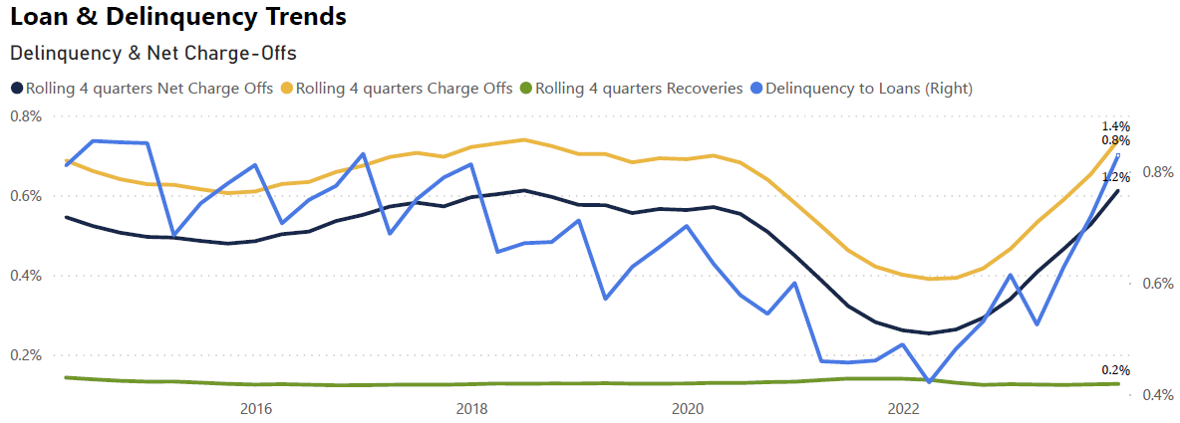
Source: NCUA’s Financial Trends in Federally Insured Credit Unions 2023 Q4

Slide 12
Polling Question
What loan delinquency and charge-off trends is your credit union experiencing?
  Increasing
  Decreasing
  Stable

Slide 13
Due Diligence Procedures

Slide 14
Evaluate the Loan Portfolio
Understand the target’s underwriting and credit administration policies and practices.
  Look at changes in the target’s loan policies or procedures that occurred in the last two to three years.
  Why was the change made and what was the resulting impact?
  Did the target have the talent and controls in place to offer any new product offerings?
How does the target risk rate/price their loans?

Slide 15
Evaluate the Loan Portfolio
Relative distribution of the consumer loan portfolio by:
  Loan to value ratios;
  Type of assets pledged as collateral against the loans;
  By FICO scores of the borrowers.
Obtain listings of loans on an interest only basis and those that have been modified (including loan modifications to borrowers experiencing financial difficulties).

Slide 16
Evaluate the Loan Portfolio
Relative distribution of the commercial loan portfolio by:
  Risk rating assignments
  Collateral type
  Seasoning (length of time the loans have been outstanding)
  Loan to value ratios
Obtain copies of these risk profile reports for two to three years to help you identify trends.

Slide 17
Evaluate the Lending Staff
Do they have necessary experience for every loan product they offered?
Has there been significant changes in the leadership in the lending area in the last three to five years? What prompted the change?
Do they have an adequate loan review function in place? Was this loan review function independent?

Slide 18
Evaluate the Lending Staff
Interview both lending department management and a sample of loan officers to:
  Obtain their views on the Credit Union’s lending philosophies and practices,
  Obtain an understanding of their experience and knowledge,
  Inquire of any problem loans where the specific reserves established for the loans may be understated.

Slide 19
Loan File Review
Select a sample of loans for individual file review.
Review at least 35 to 50 percent of the dollar amount of outstanding higher risk loans (commercial loans).
Review a sample of consumer loans to evaluate the quality and consistency of the Credit Union’s documentation and underwriting practices.

Slide 20
Polling Question
Does your credit union have adequate knowledge to complete loan review internally?
  Yes – but we will outsource
  Yes- experienced, knowledgeable lending staff
  No

Slide 21
Allowance for Credit Losses (ACL)
Obtain an understanding of the target’s ACL methodology and calculation:
  Are general reserves established for homogeneous loans?
  Are specific reserves established for non-homogeneous or collateral-dependent loans?
  Are qualitative factors and forecasting adjustments considered, quantified, and documented?
  Has the ACL methodology been validated?
  Are ACL ratios consistent with the industry?

Slide 22
ACL Ratio Analysis
Ratio
Industry Average as of 12/31/23
Evaluate the ACL as a
percentage of total loans
Evaluate delinquency as a
percentage of total loans
Evaluate ACL coverage
(ACL as a percentage of net loan charge-offs over the previous 12 months)
1.27%
0.83%
2.14 times

Slide 23
Investments
Confirm securities held in safekeeping with third parties.
Obtain an understanding of how individual securities are valued.
Identify any high-risk investments and obtain an understanding of the process used to evaluate for credit losses.

Slide 24
Asset-Liability Management
Combine the schedule of maturing/repricing of the interest-bearing assets and liabilities of your Credit Union and the target.
Does the target increase or reduce your interest rate and liquidity risk?
  Evaluate interest rate shocks positive or negative of 50, 100, and 200 basis points using the combined GAP schedules of your institution and the target.

Slide 25
Asset-Liability Management
Obtain the loan and share AIRES files and evaluate any anomalies including:
  Unusually low or high interest rates
  Loans with accrued interest greater than the payment amount (could indicate loan due date advances)
Compare and contrast the product and service offerings of your institution to the ones offered by the target.

Slide 26
Liquidity Sources
Determine the extent of borrowings and evaluate if there are any prepayment penalties.
Obtain a report of all deposit accounts with an account balance over a certain dollar amount (i.e. $250,000).
  Gain an understanding of how the target attracted the account and the nature of the relationship between the target and the member.
  Quantify the dollar amount of any brokered and internet deposits held by the target.

Slide 27
Oversight
Review any reports issued by internal and third party loan review firms.
Review prior regulatory examination reports.
Review minutes of the board of directors, supervisory committee, and credit committee for the last two years.

Slide 28
Regulatory Compliance
Bank Secrecy Act/Anti-Money Laundering/OFAC;
Flood determinations;
Member privacy disclosures;
Home Mortgage Disclosure Act (HMDA);
Disclosure of fees and charges on loan and deposit products (Truth-in-lending and Truth-in-savings).

Slide 29
Legal Matters
Examine invoices for any legal expenses paid in the prior 12 months.
  Obtain an understanding of the services performed;
  Identify potential contingent or actual unrecorded liabilities;
  Obtain attorney’s letters requesting that the attorney provide you with their assessment of the likelihood of loss and estimated losses.

Slide 30
Commitments and Contingencies
Read though any long-term agreements to determine if there are any unusual clauses or unrecorded liabilities.
  Employment agreements:
    Change in control agreements
    Deferred compensation plans
    Retention agreements
  Vendor agreements:
    Conversion fees
    Change in control clauses
    Cancellation fees
  Leases

Slide 31

Condition of Facilities
Tour any physical facilities of the target to:
  Assess the physical condition of the facility
  Note any repairs that may be needed in the near future
  Evaluate the need/viability of the location (is it located near one of your existing branch locations)

Slide 32
Other Items to Consider
Obtain a schedule of foreclosed and repossessed collateral. Determine if these assets are listed at the lower of the unpaid balance of the loan or the estimated liquidation value.
Compare key operating ratios for the target to corresponding ratios within your institution and to peer group data.

Slide 33
Other Items to Consider
Obtain a copy of the target’s human resource manual and employee benefit plans – compare and contrast to the policies and plans in place at your credit union.
Interview two to three board members, members of senior management, and sample of other employees to obtain an understanding of:
  The target’s culture
  Major strategic initiatives
  Help you in identifying strengths and weaknesses of the target and the proposed merger

Slide 34
Obtain Help from Third Parties
Quality of Earnings (Q of E)/Due Diligence
Target Valuation
Portfolio Valuations (loans/deposits)
Intangible Asset Valuations
Purchase Accounting Consulting
Contract Review and Advisory

Slide 35
Polling Question
What is your biggest concern with due diligence?
  Loan credit quality
  Contractual commitments
  Culture integration
  Other

Slide 36
Thank you!
Dean Rohne, CPA Stephen J.M. Schiltz, CPA
Principal Principal
CLA (CliftonLarsonAllen LLP) CLA (CliftonLarsonAllen LLP)
512-276-6048 520-352-1259
dean.rohne@CLAconnect.com stephen.schiltz@CLAconnect.com
36

