Slide 1
Emerging Risks Across Credit Unions and New Regulation Updates
ACUARP Region 1 Meeting – Vancouver, WA
John L Bley, Presenter
October 18, 2024

Slide 2

The only thing we know about the future is that it will be different
- Peter Drucker

Slide 3
Emerging trends up for discussion
The CFPB as Super Legislature
Cyber Attacks, Check Fraud/Payments Fraud and Malicious Account Takeover Schemes
Junk Fees
BNPL Programs
Fintech Partners and Third-Party Risk Issues

Slide 4
The CFPB as Super Legislature

Slide 5
Administrative Legislative Process

Slide 6
Administrative Legislative Process
Legislative Rules
A legislative rule, like a statute, is said to bind the public and have the “force of law.”
Under the APA (Administrative Procedures Act), a legislative rule generally cannot be issued without notice and comment, a lengthy process in which an agency publishes a proposed rule and gives the public a chance to comment on it.
The agency must give serious consideration to the comments before the rule may be finalized. Public comments sometimes significantly affect the content of legislative rules.

Slide 7
Administrative Legislative Process
Interpretive Rules
An interpretive rule is said only to advise the public of an agency’s view of what a law or regulation means.
Supposedly, an interpretive rule does not bind the public or have the force of law. Interpretive rules come in many forms, such as guidance documents, agency manuals, and interpretive bulletins.
The APA expressly provides that an interpretive rule need not go through notice and comment.

Slide 8
Administrative Legislative Process
Advisory Opinion Letters
“The Bureau’s Advisory Opinion program provides written guidance to assist regulated entities to better understand their legal and regulatory obligations through advisory opinions.”
“The Advisory Opinion program provides a mechanism through which the Bureau can carry out its statutory purposes and objectives by better enabling compliance.”

Slide 9
Legislative Process
Advisory Opinion Letters
Truth in Lending (Regulation Z); Consumer Protections for Home Sales Financed Under Contracts for Deed – August 13, 2024
Fair Credit Reporting; Background Screening – January 11, 2024
Fair Credit Reporting; File Disclosure – January 11, 2024
Consumer Information Requests to Large Banks and Credit Unions – October 11, 2023
https://www.consumerfinance.gov/compliance/advisory-opinion-program/

Slide 10
The takeaways?
The CFPB has begun rulemaking by using advisory opinion letters (interpretive rules) rather than going through the APA process. Credit unions will need to be able to react quicker to “new” requirements in these different forms.
Greater regulatory and class action risk

Slide 11
Cyber Attacks Check Fraud/Payments Fraud and Malicious Account Takeover Schemes

Slide 12
Under the Magnifying Glass
America’s Credit Unions/September 19, 2024
Fortify the Walls. Ensure good security hygiene and make sure your systems and platforms are secure. Reinforce and strengthen your systems so they are impenetrable to breach. Evaluate those systems for vulnerabilities. This is not a one and done process. It should be constant and ever evolving. Remain vigilant.
Practice What You Preach. Credit unions are constantly reminding members to guard, strengthen, and secure passwords. Credit unions should ensure that they are practicing what they preach. Administrative passwords and vendor system passwords need to be changed/strengthened frequently. Multi-factor authentication should always be used if the option/capability to do so is available. Review access credentials and permission requirements to critical systems frequently. Evaluate for vulnerabilities.
Vulnerable Vendors. As you know NCUA wants third party vendor authority for this reason. Evaluate third party vendor access and relationships to credit union systems. It shouldn’t be news that many cyber-attacks exploit vulnerability gaps in third party systems used by institutions. Vendors must be held accountable. Credit unions must ensure that the vendors they contract with are safeguarding those systems. The credit union’s reputation and your members’ funds and personal information are at stake.
Test. Test. Test. And Test Again. Stress testing of the credit union’s back-up and recovery systems should be conducted often to ensure it works as it should. It’s too late if those systems don’t function when needed. Regular and frequent back-ups of the system should be common practice. If a breach occurs there will be considerable downtime to get systems running optimally and online again. Risk to a credit union’s reputation for systems that are offline for an extended period of time is HUGE.
Member Education. Continue educating members on identity theft and password security. Unfortunately, sometimes it is ignored. Cyber threats are constant. In educating members on good security practices offer learning lesson scenarios. Bringing attention to the negative ramifications of poor security practices may drive it home for some.
Notify NCUA. A credit union must notify NCUA after the credit union reasonably believes it has experienced a reportable cyber incident OR received a notification from a third party regarding a reportable cyber incident.

Slide 13
Account Takeover
Both “high tech” and “low tech”
Bad actors are using the dark web to identify member history and using that information against a member to dupe the CU into thinking they are actually talking to the member when they are not
Be careful about the effectiveness of security questions
Use multi-factor authentication and out-of-band communication strategies
Are your “security procedures” for member identification state-of-the-art?
The more at stake, the greater the risk, the greater the safeguards have to be

Slide 14
Regulation E

Slide 15
Regulation E
The CFPB provided a Statement of Interest in New York v. Citibank stating that the Electronic Fund Transfer Act (EFTA) applies when banks connect the capability to initiate wire transfers to a consumer-facing banking platform.
The brief argues that EFTA’s wire transfer exclusion, which applies to transfers made “by means of” a wire service, excludes only bank-to-bank wire transfers from EFTA’s consumer protections. When banks connect wire transfer capabilities to consumer-facing online banking platforms, an online-initiated wire transaction meets the definition of an “electronic fund transfer” and only the bank-to-bank wire portion of that transaction is excluded from EFTA and Regulation E coverage. The remaining electronic fund transfer is subject to EFTA and its implementing Regulation E.
New York v. Citibank, N.A. | Consumer Financial Protection Bureau (consumerfinance.gov)

Slide 16
Regulation E
There has been a lot of focus on determining the liability on person-to-person (P2P) transfers using services such as Zelle.
The WSJ reports that the CFPB is investigating JPMorgan Chase, Bank of America, Wells Fargo, and others do enough to shut down accounts controlled by bad actors. (08/07/22024)
Financial App Security (S.8677) – NY (https://www.nysenate.gov/legislation/bills/2023/S8677/amendment/B)
An oversight hearing to examine how Zelle and the big banks fail to protect consumers from fraud. (https://www.congress.gov/event/118th-congress/senate-event/336040)
CFPB Proposes to supervise digital wallets and payment apps. (https://www.consumerfinance.gov/about-us/newsroom/cfpb-proposes-new-federal-oversight-of-big-tech-companies-and-other-providers-of-digital-wallets-and-payment-apps/)

Slide 17
Junk Fees

Slide 18
Junk Fees
CFPB Issues Guidance to Halt Large Banks from Charging Illegal Junk Fees for Basic Customer Service
  Advisory Opinion (https://files.consumerfinance.gov/f/documents/cfpb-1034c-advisory-opinion-2023_10.pdf)
  Requires large banks and CUs (over $10 billion) to comply with consumer requests for information concerning a “consumer financial product or service” in a timely manner
  Cannot unreasonably impede a consumers’ ability to request and receive account information
  But it is not an unreasonable impediment for large banks or credit unions to require that the person making the request verify their identity, identify their account, and describe the information they are seeking.

Slide 19
BNPL Programs

Slide 20
BNPL Programs
Top-Level Takeaways – Callahan & Associates. creditunions.com, Buy Now, Pay Later: Fad or the Future? September 9, 2024
  Despite its popularity among consumers, a 2024 survey found only 1.5% of credit unions currently offer BNPL.
  Credit unions have reduced BNPL risks by introducing it to members as a post-purchase option.
  Credit unions with BNPL programs report that members who use it largely use it for essential purchases*, such as household needs and groceries.
  *For example, a member to take advantage of Capitol Credit Union’s BNPL program, they must have been a member for at least 180 days and be in good standing. Eligible purchases must be from within the past 60 days, be at least $100, and cannot be a cash or cash equivalent purchase. Capitol sets a fixed interest rate of 15% but charges no other fees.

Slide 21
Who is providing this service now?
“Fintechs are the ones providing this for the consumer right now,” says Pierre Cardenas, CEO of Capitol Credit Union ($213.2 M, Austin, TX). “The credit union industry better hop on board because members are going to keep going to these other options first.”(https://creditunions.com/analyze/pro le/? account=339784&acc=0016000000EhUdoAAF)
Pierre Cardenas, CEO, Capitol Credit Union
So… let’s talk about partnering with Fintechs

Slide 22
Fintechs

Slide 23
Fintechs – Managing third-party risk
Third-Party Risks, ACUIA 33rd Annual Conference, June 15, 2023
Authorities
  NCUA Letter to Credit Unions 08-CU-09 (April 2008)
  Interagency Guidance on Third-Party Relationships: Risk Management FDIC PR-47-2023 (June 2023)
Examiners divide their analysis into three broad categories
  Risk Assessment and Planning;
  Effective Due Diligence; and
  Risk Measurement, Monitoring, and Control
Lending programs greater legal risk than payments programs
FDIC Proposes Deposit Insurance Recordkeeping Rule for Banks’ Third-Party Accounts, September 17, 2024* Rule will have compliance implications for BaaS partnerships.
*https://www.fdic.gov/news/press-releases/2024/fdic-proposes-deposit-insurance-recordkeeping-rule-banks-third-party

Slide 24
And if you haven’t had enough…

Slide 25
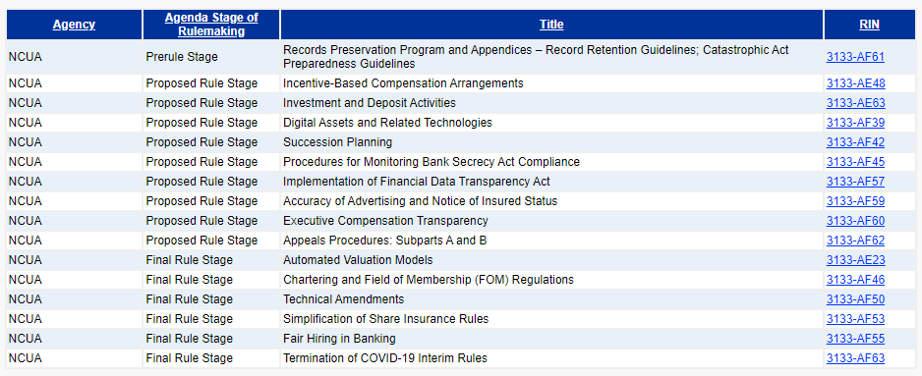
NCUA Agency Rule List – Spring 2024

Slide 26
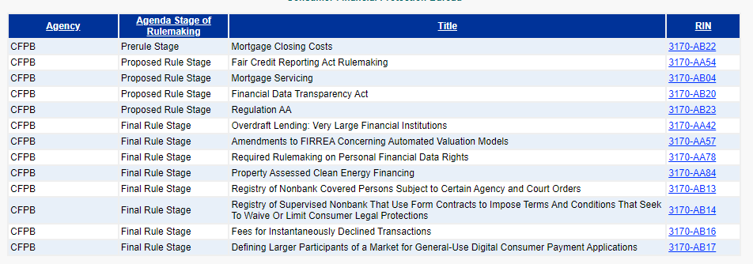
CFPB Agency Rule List – Spring 2024

Slide 27
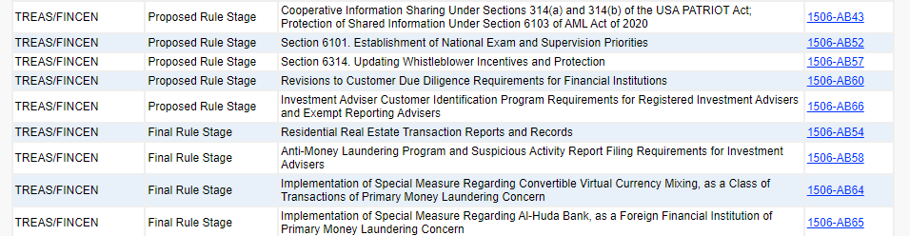
FinCEN Rule List – Spring 2024

Slide 28

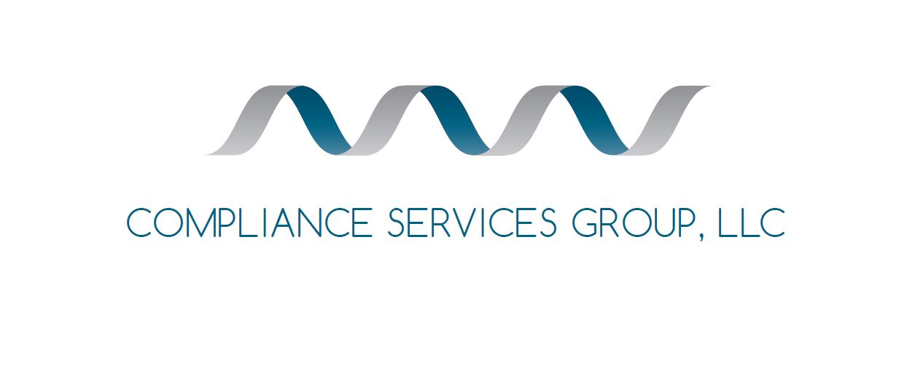
John.Bley@complianceservicesgroup.com ph. 360.402.1077

