Slide 1
Quality Assurance: Implementing the
New Global IIA Standards at your CU
ACUARP Region 4 Meeting
Oct 17, 2024

Slide 2
Meet the Presenters
Olivia Whipple, CIA
John Kaneklides, CIA
olivia@theauditlibrary.com
john@theauditlibrary.com

Slide 3
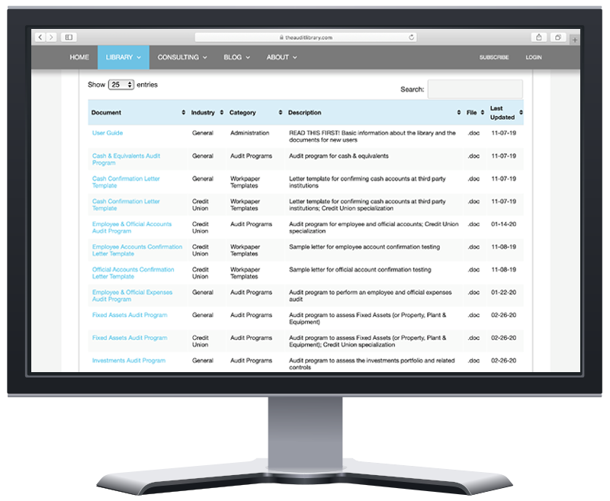
What is the Audit Library?
Digital tools & templates for Internal Auditors
Credit Unions are our passion!
Subscribers access a growing library of audit programs & workpapers, planning & budgeting tools, quality assurance, and more!
Quarterly training for CPE credit included in subscription
Follow our FREE - The Audit Library Blog & Newsletter
Consulting: Quality Assurance Reviews

Slide 4
Agenda
Quality Assurance in the New IIA Standards
Quality Assurance and Improvement Programs
External Assessments
Preparing for a QAR
Internal Assessments
Please ask questions and we will have meaningful discussions!

Slide 5
Standard 8.3 Quality
The chief audit executive must develop, implement, and maintain a quality assurance and improvement program that covers all aspects of the internal audit function. The program includes two types of assessments:
External assessments (see Standard 8.4)
Internal assessments (see Standard 12.1)
At least annually, the chief audit executive must communicate the results of the internal quality assessment to the board and senior management. The results of the external quality assessments must be reported when completed.

Slide 6
Standard 8.4 External Quality Assessment
The chief audit executive must develop a plan for an external quality assessment and discuss the plan with the board. The external assessment must be performed at least once every five years by a qualified, independent assessor or assessment team. The requirement for an external quality assessment may also be met through a self-assessment with independent validation.
When selecting the independent assessor or assessment team, the chief audit executive must ensure at least one person holds an active Certified Internal Auditor designation.

Slide 7
Standard 12.1 Internal Quality Assessment
The chief audit executive must develop and conduct internal assessments of the internal audit function’s conformance with the Global Internal Audit Standards and progress toward performance objectives. (…)
Based on the results of the periodic self-assessments, the chief audit executive must develop action plans to address instances of nonconformance with the Standards and opportunities for improvement, including a proposed timeline for actions. The chief audit executive must communicate the results of periodic self-assessments and action plans to the board and senior management. (…)

Slide 8
Key Takeaways from the New Standards
The requirements have not changed, and much of the wording is straight from the previous version of the Redbook
There is now additional guidance for the board (committee) and senior management
The considerations for implementation guidance is clear and succinct
The examples of evidence of conformance is a brand new element of the Redbook and will be very helpful in external and internal assessments

Slide 9
Questions for the Group??
Do you have a Quality Assurance and Improvement Program in place currently?

Slide 10
Quality Assurance and Improvement Program
Title page
Executive Summary
Background
5-10 Action Steps
Step 1: External Assessment
Step 2: Internal Assessment
Conclusion
A Quality Assurance and Improvement Program Template is available for The Audit Library subscribers

Slide 11
Possible QAIP Action Steps
Improve department productivity
Improve efficiency/realization rates
Obtain certifications (CPA, CIA, CCUIA, etc.)
Promote from within
Improve audit turnaround time
Implement post-engagement surveys
Transparency and accountability initiatives
.

Slide 12
Questions for the Group??
When was your last Quality Assurance Review?

Slide 13
External Assessments
Quality Assurance Reviews
Most common type of external assessment
Can provide valuable insights in addition to meeting Standard 8.4
Could be performed more frequently than every 5 years
Internal Assessment Validation
Not commonly used
Many external firms will not provide the validation service
Peer Review
Three peer credit unions assess each other
Commonly discussed and considered, but not commonly used

Slide 14
Quality Assurance Review Phases
Planning
Documentation Review
Internal Audit Quality Control
Internal Audit Planning, Budgeting, and Time-Tracking
Supervisory Committee
Work Quality Review
Internal Audit Reputation
Finalization, Review, and Reporting
.

Slide 15
Preparing for your Quality Assurance Review
Is your Quality Assurance and Improvement Program up and running?
Are all of your Internal Audit governing documents current?
Do you have an Internal Audit Strategic Plan, and is it regularly reviewed and updated?
Was a risk assessment performed in the past year?
Do you have a working audit plan with reporting capabilities?
Any chronic audit workpaper errors or issues to work on?
Is your audit issue tracking process meeting your credit union’s needs?
Is documentation/evidence being maintained via your committee minutes?
Have you completed a self-assessment in the past year?

Slide 16
Final Question for the Group??
When was the last time you performed a self-assessment?

Slide 17
Internal Assessments
Work program available for subscribers
Many other options are readily available
Completing a self-assessment is good practice/preparation for your Quality Assurance Review
Relatively quick and easy project (20-30 hours estimated)
By definition, you are not independent. BUT you can still be objective about your own work, and gain valuable insights from this process!

Slide 18
Helpful Links
https://theauditlibrary.com/2022/06/03/preparing-quality-assurance-review/
https://theauditlibrary.com/2019/05/13/quality-assurance-reviews/

Slide 19
Thank You!
WWW.THEAUDITLIBRARY.COM
Olivia Whipple, CIA
John Kaneklides, CIA
olivia@theauditlibrary.com
john@theauditlibrary.com

